Slide 1
Data Visualization
Session 3
Stephan Kadauke
July 16, 2020
Notes:
Hello everyone, and welcome to session 3 – Visualization. I’m Stephan Kadauke from the Children’s Hospital of Philadelphia.

Slide 2
July 16 2020 | Session | Instructor
1:00 pm - 1:30 pm | Instructor Introductions, Introduction to technology | Amrom Obstfeld
1:30 pm - 2:15 pm | Introduction to R and RStudio | Joe Rudolf
2:30 pm - 3:15 pm | Reproducible Reporting | Patrick Mathias
3:30 pm - 5:00 pm | Data Visualization | Stephan Kadauke
July 17 2020
1:00 pm - 2:30 pm | Data Transformation | Amrom Obstfeld
2:45 pm - 4:15 pm | Statistical Analysis | Dan Herman
4:30 pm - 5:00 pm | Advanced Reporting | Patrick Mathias
Notes:
In this block, we’ll dive deeper into one or the main generators of knowledge and understanding in data analysis: visualization.

Slide 3
Goals
Appreciate the importance of visualization for understanding data
Learn how to use ggplot2 to visualize data
Objectives
Create a basic visualization using a simple template
Define “aesthetic mapping” and explain how aesthetic mappings relate variables of a data frame to features of graphic markings on a plot
Write the code to specify a type of plot and fine tune its appearance using “geom” functions
Explain how to add layers to a ggplot object to create complex and highly customized visualizations

Slide 4
Your Turn 1
Consider the covid_testing data frame.
What do you think plot would look like in which:
the x-axis represents pan_day (day of the pandemic), and
the y-axis represents the number of tests that were performed on that day?
Notes:
Let’s start with an exercise. (read)

Slide 5
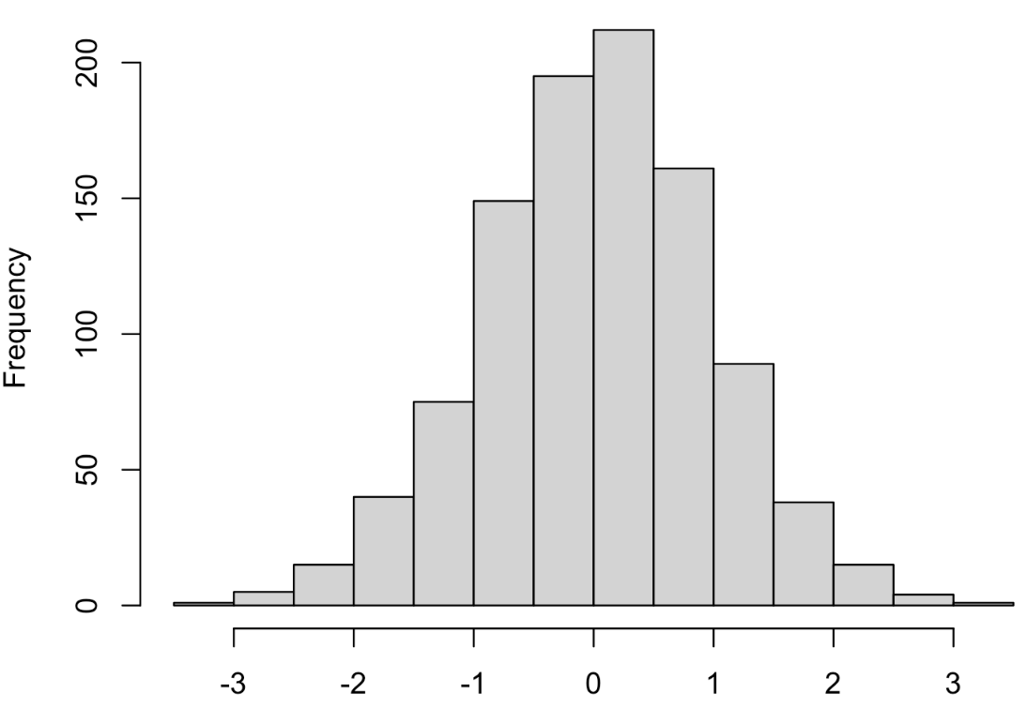
Your Turn 2
What is the name of this kind of plot?
Type the answer into the chat!

Slide 6
Your Turn 3
Type the following code in the RStudio console to make a graph.
Pay attention to the spelling, capitalization, and parentheses!
ggplot(data = covid_testing) +
geom_histogram(mapping = aes(x = pan_day))

Slide 7
When you run this code, you will get what looks like an error but is actually just a message.
R lets you know that when you ask it to draw a histogram you should tell it how wide each bin should be, because this affects the granularity of the data displayed.
ggplot(data = covid_testing) +
geom_histogram(mapping = aes(x = pan_day))
Notes:
**Delete from PDF deck**
This is a useful message, and we will later on look at how to do that.

Slide 8
ggplot(data = covid_testing) +
geom_histogram(mapping = aes(x = pan_day))
Notes:
**Delete from PDF deck**
When I asked you to imagine what this plot might look like - the number of COVID tests that were performed on a given day over time – you might have imagined something like this. Initially you have very few tests, because the pandemic hasn’t started yet and also the test may not yet be broadly available. And at some point the number of tests shoot up and remain at a high level. But this simple visualization tells you so much more than that general shape. You can see that by 30 days, the testing ramp-up settled. And it tells you a few things you might not have expected and that may make you want to look at particular aspects of the data – like, what’s going on with the humps starting around day 80?
None of this would be apparent from looking at a table with 15,000 rows.
The point of this exercise is that you might have some ideas about your data, but usually they are incomplete and often times they are wrong. Being able to visualize data quickly is critical for understanding.

Slide 9
Notes:
We’ll be using the ggplot2 package for creating graphics. ggplot2 is part of the tidyverse so it will get loaded when you load the tidyverse package.
GGplot provides a "grammar of graphics" for data visualization. The idea is that you can build any type of graph by specifying the data, a the type of graph, and a mapping that describes how the data should be represented as visual marks on that graph.
So there should be a consistent way, or a grammar, to construct any type of graph.
The advantage of ggplot2 over other graphics packages for R is this consistent grammar, which makes it easy to generate a lot of different graphs quickly to help your understand your data. So that means that when you’ve learned how to make a scatterplot you don’t have to learn a totally new way to make a histogram, or some other kind of graph.
In addition, ggplot2 graphs are aesthetically pleasing and can be used to generate publication-quality plots.

Slide 10
ggplot()
+ sign
before new line
Always start with ggplot()
data frame
ggplot(data = covid_testing) +
geom_histogram(mapping = aes(x = pan_day))
mappings inside
aes() function
type of plot
x axis
mapping
Notes:
So here a quick analysis of how we just used ggplot to make that graph.
You can see that we give it a data frame, in this case, our covid_testing data
We specify the type of plot, or “geom”, in this case, a histogram
And we specify an aesthetic mapping. In this case, we’re saying that we want the x axis to represent the pan_day. Since this is a histogram, I don’t have to specify that the y axis should be the count of rows in the table.
A few more details to note: you always start a plot with the ggplot() function
To connect the ggplot function to the geom function you use a ‘+’ sign which should be put at the end of the line, followed by a newline.
And the mappings need to go inside the aes() function. Aes is for “aesthetic mapping” which I’ll talk about shortly.

Slide 11
To make any kind of graph:
1. Choose a “tidy”
data frame
ggplot(data = data_frame) +
geom_function(mapping = aes(mappings))
3. Write aesthetic mappings
Notes:
So that was a lot of information. Let’s try to consolidate this into a more general template. Here’s a template for making any kind of graph with ggplot2.
You start with the code written in black – black is constant - and fill in the details written in blue.
Step 1. Specify a tidy data frame <- this contains the data you want to plot.

Slide 12
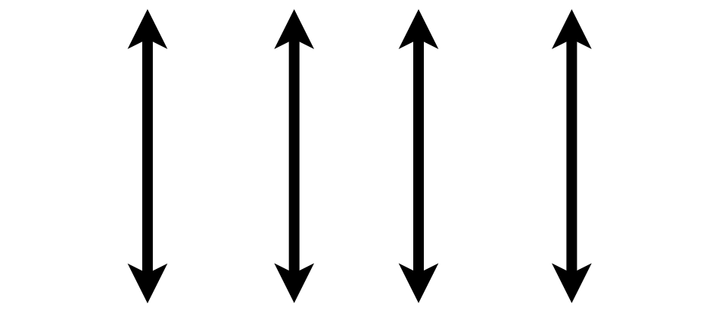
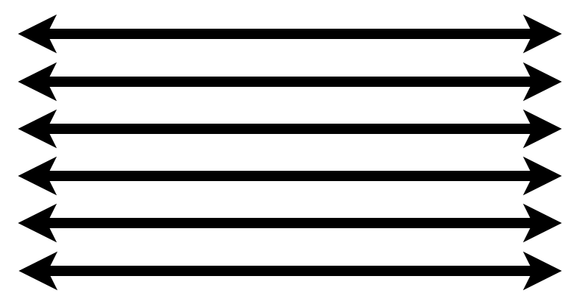
1. Pick a “Tidy” Data Frame
A data set is tidy if:
Each variable is in its own column
Each observation is in its own row
Each value is in its own cell
Notes:
This is a good time to review the idea of ”tidy” data that also gives the “tidyverse” its name.
Any data set can take on a lot of different shapes. But there is one shape that is best suited for data analysis, and that shape is called ”tidy.”
A data set is tidy if: each variable is in its own column,
Each observation is in its own row, and
Each value is in its own cell
The opposite of “tidy” is often called “messy.” And often times a lot of the data analysis work is to convert “messy” data into “tidy data.”
Fortunately for us, the covid_testing data set is tidy already.

Slide 13
To make any kind of graph:
1. Choose a “tidy”
data frame
ggplot(data = data_frame) +
geom_function(mapping = aes(mappings))
2. Pick a “geom” function
Notes:
Step 2. Pick a geom function <- this is the type of plot you want to create.

Slide 14
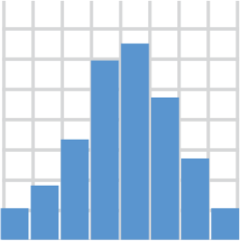
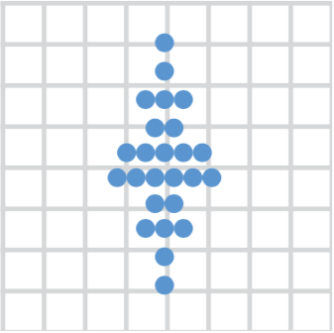
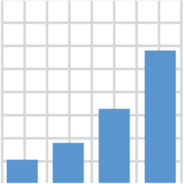
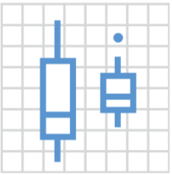
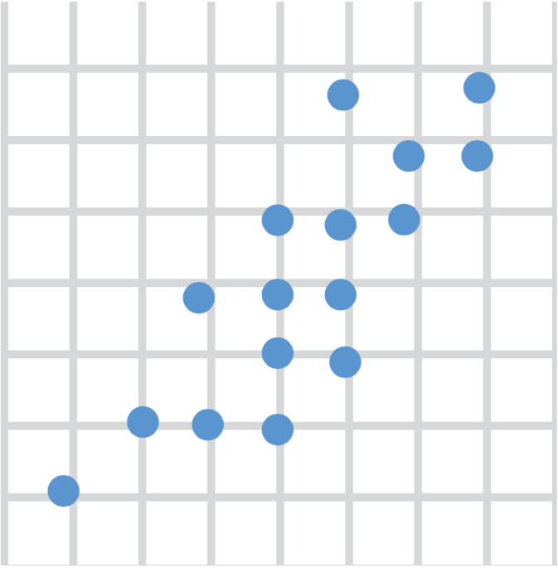
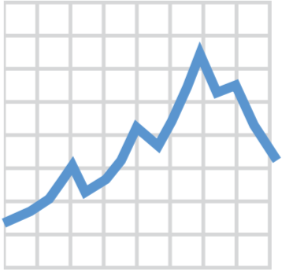
2. Choose a “Geom” Function
geom_histogram()
geom_dotplot()
geom_bar()
geom_boxplot()
geom_point()
geom_line()
Notes:
We’ll go into more detail about what geom functions are, but for now, just know that you need to tell ggplot what type of graph you want, and you do that by picking the right geom_ function.
Here are a couple of useful geom functions for visualizing clinical data, but there are many more. With these 6 you can make histograms, bar plots, scatter plots, dot plots, boxplots, and line graphs.

Slide 15
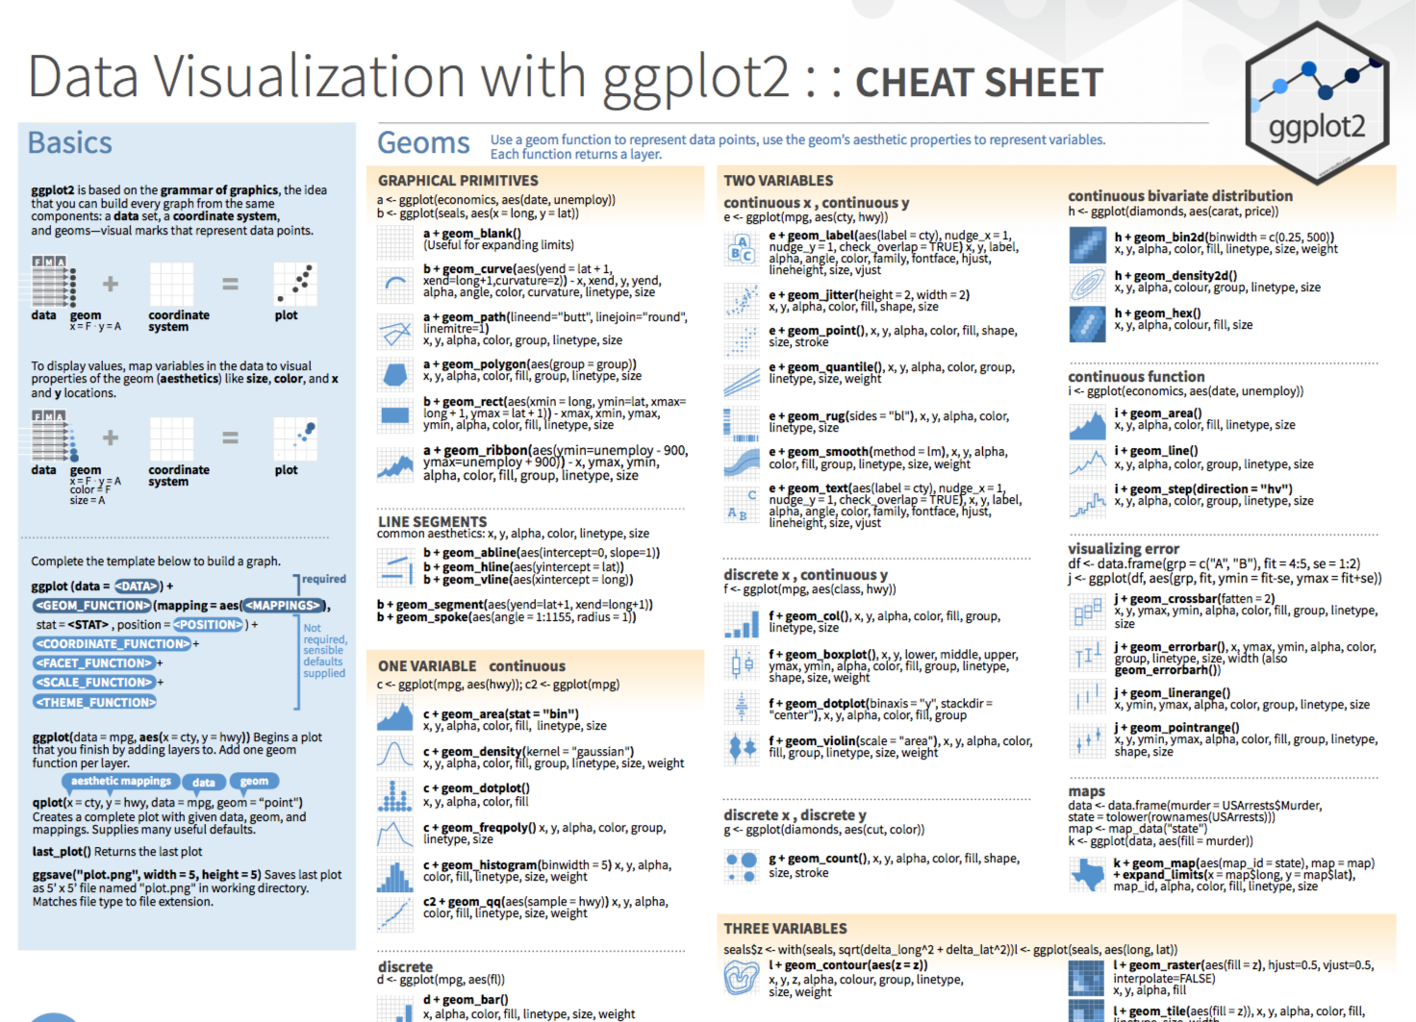
Notes:
The ggplot2 Cheat Sheet which is in the Resources section of the course website is great to have on hand as you’re exploring your data with ggplot. It reviews the basic template for building any plot and also list the most useful geom functions.

Slide 16
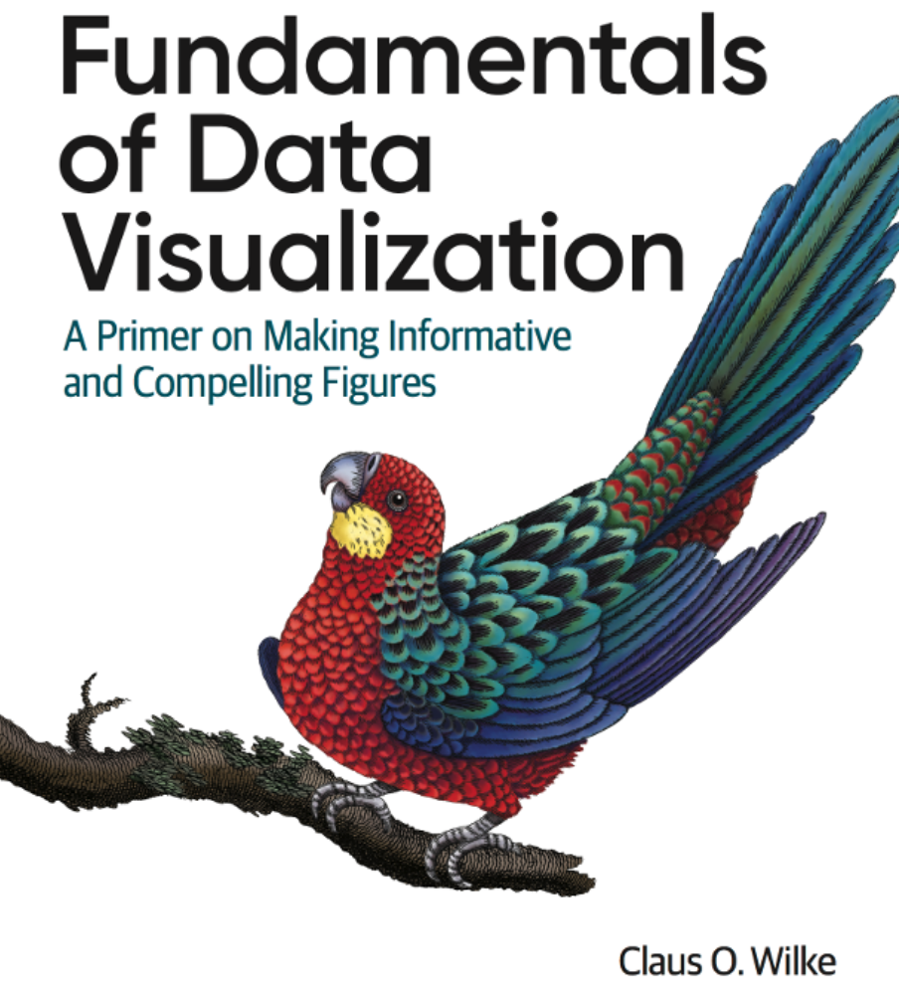
https://serialmentor.com/dataviz
Notes:
If you’d like to learn more about which graphics are most effective in specific situations, I highly recommend taking a look at Fundamentals of Data Visualizations by Claus Wilke. This is a very readable and recent primer on data visualization and figure design, and it’s available for free at the address shown on the slide. No need to write it down, as it’s also listed in the Resources.

Slide 17
To make any kind of graph:
1. Choose a “tidy”
data frame
ggplot(data = data_frame) +
geom_function(mapping = aes(mappings))
2. Pick a “geom” function
3. Write aesthetic mappings
Notes:
Step 3 is to write aesthetic mappings. This is where you tell ggplot how you want the columns of the data frame represented on the plot.

Slide 18
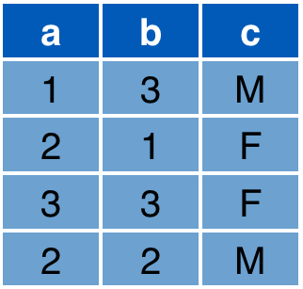

3. Write Aesthetic Mappings
aes(x = a, y = b, color = c)
Data frame
Graph
y
x
Notes:
So what's an aesthetic and what’s an aesthetic mapping?
An aesthetic is a thing that we can perceive about a data element on a graphic, such as its position but also for example its color.
An aesthetic mapping is a specification of how the columns of a data frame should be represented as things we can perceive on the plot.
For example: consider this data frame with 3 columns: a, b, and c; and this 2D graph with an x and y axis.
The aesthetic mapping above defines that x axis value of each marking should be derived from the "a" column
The y axis value from the "b" column
And that the color should come from the "c" column.
As a result, you get the following graph, which visually encodes all the information from those 3 columns in the data frame. (R figures out a reasonable axis limits and a reasonable color scale automatically, but you can fine tune this.)
Aesthetics are a powerful and fundamental concept in the grammar of graphics so let’s do a Your Turn to explore this idea a little further.

Slide 19
Your Turn 4
In addition to x/y position and color, what other aesthetics can you think of?
Type your answers in the chat!

Slide 20
Aesthetics
From Fundamentals of Data Visualization, by Claus Wilke, licensed under CC-BY-NC-ND
Notes:
*** Don’t include in PDF deck ***
So there’s actually a lot, and they depend on the kind of plot you’re making. For example, for a line graph you can define line width and line type, and for scatter plots you can define the shape of the dots. Picking the best aesthetics for your graph is as much an art as it is a science, and again I recommend Claus Wilke’s Fundamentals of Data Visualization for a great introduction to this topic.

Slide 21
To make any kind of graph:
1. Choose a “tidy”
data frame
ggplot(data = data_frame) +
geom_function(mapping = aes(mappings))
2. Pick a “geom” function
3. Write aesthetic mappings
Notes:
So here’s the final template. To recap,
Choose a tidy data frame <- this contains the data you want to plot
Pick a geom function <- this is the type of plot you want to create
Write aesthetic mappings

Slide 22
Your Turn 5
Open 03-Visualize.Rmd. Work through the exercises of the section titled “Your Turn 5.”
Notes:
** Breakouts **

Slide 23
Setting vs Mapping Aesthetics
Notes:
Let’s spend the next few minutes on an important conceptual distinction about how you can define aesthetics in your plot.

Slide 24
How would you make this plot?
Notes:
Consider this plot. It’s the same as the one you’ve created at the beginning of the session, except the dots are blue, not black. So the difference is the color aesthetic. But we’re not really mapping the color aesthetic to a variable here, because all plots are the same color. They don’t represent the values of a variable of a data frame. Instead, we’re setting it to a constant value, the color blue. Let’s look at how this is done.

Slide 25
Inside of aes():
map an aesthetic to a variable
ggplot(data = covid_testing) +
geom_histogram(mapping = aes(x = pan_day, fill = result))
Notes:
In the exercise you just mapped the fill aesthetic to the result variable, by adding ”fill = result” to the list of definitions inside the aes function, highlighted here in red.
The general rule is: if an aesthetic is defined inside of the aes function then that aesthetic gets mapped to a variable (or column).

Slide 26
Outside of aes():
set an aesthetic to a value
color name in “quotes”
ggplot(data = covid_testing) +
geom_histogram(mapping = aes(x = pan_day), fill = "blue")
Notes:
If the aesthetic is defined outside of the aes function (but still inside of the geom function) – then it’s set to a constant value, like “blue”. R knows a lot of different colors by their English name.
Color names need to be put into quotes.

Slide 27
ggplot(data = covid_testing) +
geom_histogram(mapping = aes(x = pan_day, fill = result))
ggplot(data = covid_testing) +
geom_histogram(mapping = aes(x = pan_day), fill = "blue")
Notes:
To recap setting vs mapping aesthetics:
If you define an aesthetic inside aes() -> aesthetic gets mapped to a variable of the data frame
If you define an aesthetic outside aes() -> aesthetic gets set to constant value

Slide 28
Geom Functions
Notes:
We’ve briefly looked at geom_ functions earlier and you might now appreciate how that makes it so easy to switch out one type of graph for another. But let’s dive a bit deeper into the concept of geom functions.

Slide 29
How are these plots similar?
Same: x axis, y axis, data
Notes:
Consider these two plots. How are they similar?
* The x axis is the same, pan_day,
* and the y axis as well, count.
* Actually, the underlying data is the same as well.

Slide 30
How are these plots different?
Different geometric object (“geom”) used to represent the data
Notes:
What’s different is that on the left, the data is shown as a histogram, and on the right, it’s shown as a frequency polygon.
* So a geom function is a function that, given the data, and aesthetic mappings, generates the geometric object used to represent the data.

Slide 31
ggplot(data = data_frame) +
geom_function(mapping = aes(mappings))

Slide 32
Your Turn 6
Open 03-Visualize.Rmd. Work through the exercises of the section titled “Your Turn 6.”
Notes:
** Breakouts **

Slide 33
Global vs Local Settings
Notes:
One last fundamental idea in ggplotting is the distinction between global settings that apply to all parts of a ggplot - and local settings that only apply to a specific geom function.

Slide 34
Inside of geom_ function: apply locally to only the current layer
Inside of ggplot(): apply globally to every layer
ggplot(data = covid_testing) +
geom_histogram(mapping = aes(x = pan_day)) +
geom_freqpoly(mapping = aes(x = pan_day))
ggplot(data = covid_testing, mapping = aes(x = pan_day)) +
geom_histogram() +
geom_freqpoly()
empty ()
Notes:
Take a look at the code from the last exercise, which I’ve reproduced here on the slide. We are plotting the covid_testing data frame, and there are two geoms: the first is a histogram defined by geom_histogram. And the second is a frequency polygon defined by geom_freqpoly. But look at the mappings. They are identical, and that seems like unnecessary repetition. It would be nice if you could define mappings globally for all parts of your plot.
Turns out you can. You can move the mapping argument inside the ggplot() function, and it will apply globally to every layer.
Notice how geom_histogram and geom_freqpoly now both have empty parentheses. That’s because now both the data and the mapping are defined globally in the ggplot function.
What if you have an aesthetic set globally but want to override it for a single layer? That works as well. The local setting always overrides the global setting.

Slide 35
How would you make this plot?
ggplot(data = covid_testing, mapping = aes(x = pan_day)) +
geom_histogram(mapping = aes(fill = result)) +
geom_freqpoly(color = "blue")
Notes:
Let’s look at a final example to review global vs local definitions and setting vs mapping.
How would you make this plot?
Looks like we have 2 geoms – a histogram and a frequency polygon, both with the same underlying data – so the data should be defined globally by writing data = covid_testing in the ggplot() function.
The x and y mappings are the same for each geom, so we can make these two mappings global as well.
But now let’s look at the histogram. Here we want to map the fill aesthetic to the result value. Because that mapping only applies to the histogram and not to the frequency polygon, we make it local here, inside of the geom_histogram function.
Similarly, to make the frequency polygon line blue, we define the color aesthetic locally. Note that the color aesthetic here is not a mapping – it’s constant throughout the plot.

Slide 36
What Else?
Notes:
In this last part of this session, I want to show a few additional things you can do with ggplot, without going into much detail.

Slide 37
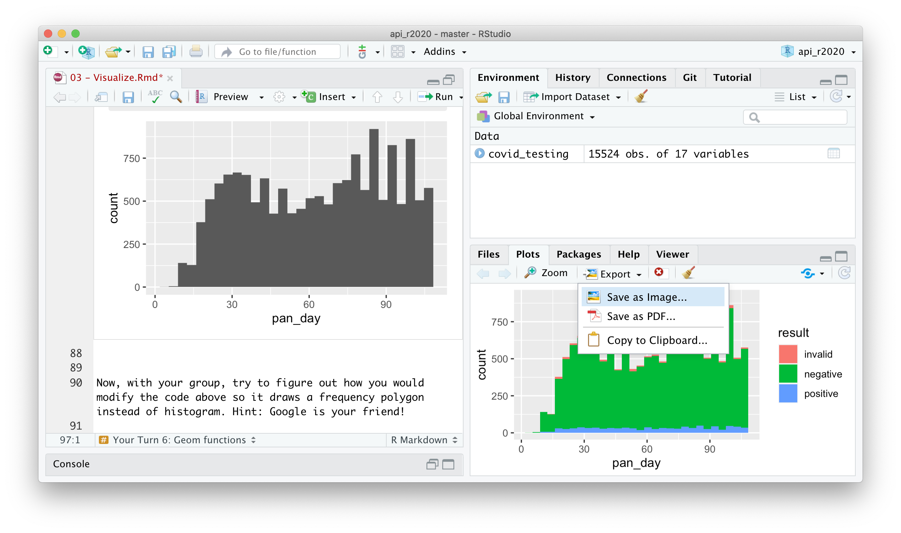
Manually saving plots
Plots > Export > Save as Image…
Right Click >
Save Image As…
Notes:
To save a plot you’ve created in the console, you can go to the Plots pane on the bottom right of the RStudio window, click export, and select Save as Image.
To save a plot you’ve created in a R notebook, you can right-click and select “Save image as”

Slide 38
Position adjustments
How overlapping objects are arranged
Notes:
We’ve only scratched the surface of what you can do with ggplots, especially when you combine them with data wrangling tools that you’ll learn about tomorrow. For example, you can change how overlapping objects are arranged, for example from a stacked histogram to side-by-side bars.
ggplot(covid_testing) +
geom_histogram(
mapping = aes(x = pan_day, fill = result),
position = position_dodge()
)

Slide 39
Themes
Visual appearance of non-data elements
Notes:
You can use different themes which affect how non-data elements such as axes, gridlines, and background appear.
ggplot(covid_testing) +
geom_histogram(
mapping = aes(x = pan_day, fill = result),
position = position_dodge()
) +
theme_light()

Slide 40
Scales
Customize color scales and other mappings
Notes:
You can customize color scales.
library(colorspace)
cols <- c(
"invalid" = "grey80",
qualitative_hcl(2, palette = "dark3")
)
ggplot(covid_testing) +
geom_histogram(
mapping = aes(x = pan_day, fill = result),
position = position_dodge()
) +
theme_light() +
scale_fill_manual(values = cols)

Slide 41
Facets
Subplots that display subsets of the data
Notes:
You can facet your plot. That means, breaking it into sub-plots by another variable, for example gender or location in the hospital.
ggplot(covid_testing) +
geom_histogram(
mapping = aes(x = pan_day, fill = result)
) +
theme_light() +
scale_fill_manual(values = cols) +
facet_wrap(~demo_group)

Slide 42
Coordinate systems
Notes:
You can easily make radial plots or geographical maps.
ggplot(covid_testing) +
geom_histogram(
mapping = aes(x = pan_day, fill = result)
) +
theme_light() +
scale_fill_manual(values = cols) +
facet_wrap(~demo_group) +
coord_polar()

Slide 43
Titles and captions
Notes:
An you can add titles, subtitles, or annotations, and change the axis labels or the appearance.
ggplot(covid_testing) +
geom_histogram(
mapping = aes(x = pan_day, fill = result)
) +
theme_light() +
scale_fill_manual(values = cols) +
facet_wrap(~demo_group) +
coord_polar() +
ggtitle(
label = "COVID19 test volume",
subtitle = "Displayed in polar coordinates, mostly to show off ggplot2"
)

Slide 44
ggplot(data = data_frame) +
geom_function(mapping = aes(mappings)) +
theme_function +
scale_function +
facet_function +
coordinate_function +
...
Required
Optional
Notes:
All of these elements, like position adjustments, themes, color scales, facets, coordinate systems, and text can be added to a ggplot command in the same way that we added geom layers – by writing a plus sign followed by a theme function, a scale function, a facet function, etc. You can find out about these functions on the Data Visualization Cheat Sheet.

Slide 45
Goals
Appreciate the importance of visualization for understanding data
Learn how to use ggplot2 to visualize data
Objectives
Create a basic visualization using a simple template
Define “aesthetic mapping” and explain how aesthetic mappings relate variables of a data frame to features of graphic markings on a plot
Write the code to specify a type of plot and fine tune its appearance using “geom” functions
Explain how to add layers to a ggplot object to create complex and highly customized visualizations

